Slide 1
Online Supermarket

Slide 2
introduction
Anyone needs a lot of groceries but they don’t have time to go to a supermarket to buy their needs
So we thought how to supply their needs in the most comfortable way
This project is an online supermarket where you can order groceries while you at home !

Slide 3
features
- admin can add a new product
- admin can delete product
- admin can update product
- user can see product without make signup
- user must make signup to have a cart to can add product to it

Slide 4
- admin and user can make logout and login again
- if user or admin forget their password can get verification
code to his email to can reset anew password

Slide 5
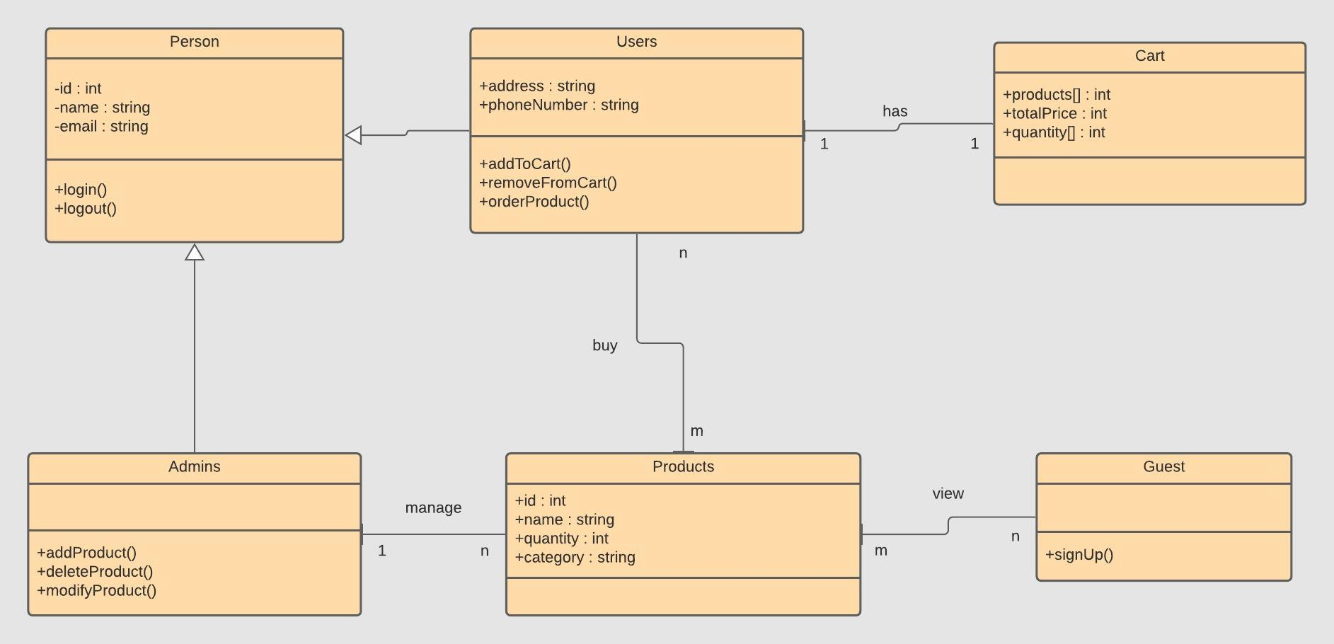
Uml diagram

